Slide 1
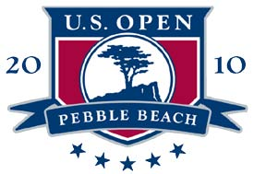
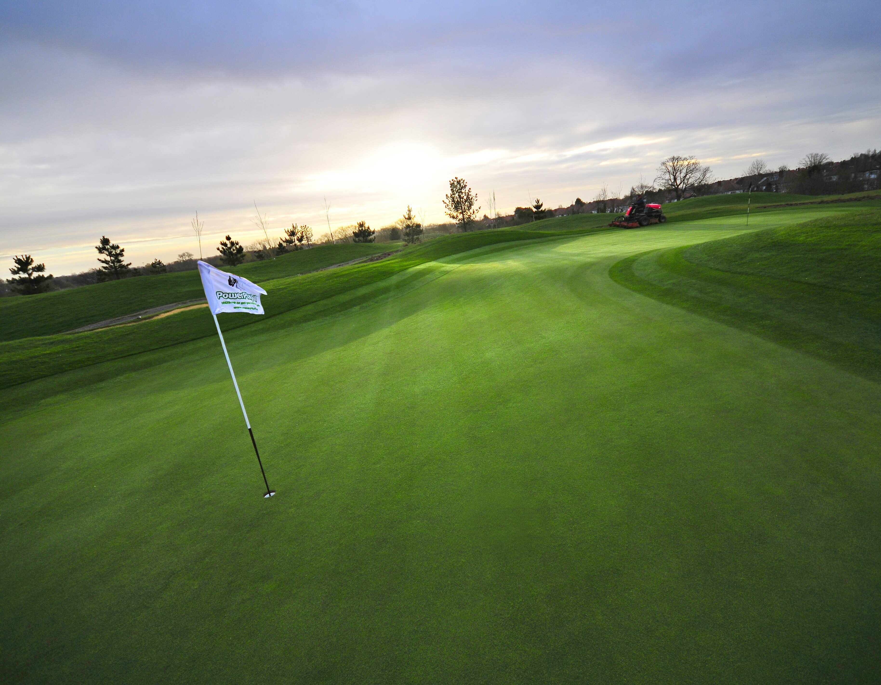
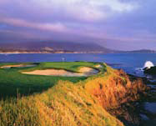
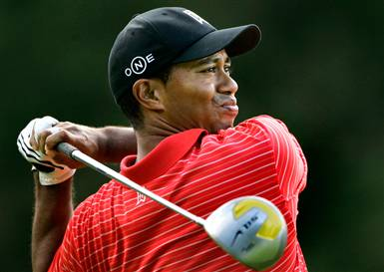
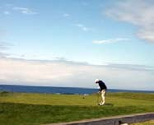
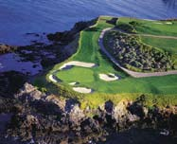
US OPEN
PEBBLE BEACH, CA
June 14 - 20, 2010
Join Broach Sports Tours at the 2010 U.S. Open Golf Championship to see the
game’s most brilliant players fight for victory at the famed Pebble Beach Golf Links in
Pebble Beach, California. See history made as one golfer joins the ranks of previous
champions, such as Jack Nicklaus, Tom Watson, Tom Kite, and Tiger Woods.
Contact: Carlos@Broachsportstours.com or 1-800-8496345

Slide 2
US OPEN 2010
June 14-20, 2010
Hogan Package
INCLUDED FEATURES:
Your choice of:
  (2) nights deluxe hotel accommodations in Monterey
  (2) nights in a four bedroom private luxury home
  Maid service included
  Check-in Wednesday, June 16, Check-out Friday, June 18
Grounds ticket to the US Open
  Thursday, June 17 and Friday, June 18
Executive Club Hospitality
  Thursday, June 17 and Friday, June 18
BST ticket holder
Round-trip transportation to the event
All taxes included
Hotel Option
Total investment per person:
Double Occupancy: $2295 Single Occupancy: $2,695
4-Bedroom Private Home Option
Total investment per person: $2,988*
Based on 4 person occupancy. Estate houses also available. Please contact your BST sales representative for pictures and pricing
Contact: Carlos@Broachsportstours.com or 1-800-849-6345

Slide 3
US OPEN 2010
June 14-20, 2010
Palmer Package
INCLUDED FEATURES:
Your choice of:
  (3) nights deluxe hotel accommodations in Monterey
  (3) nights in a four bedroom private luxury home
  Maid service included
  Check-in Friday, June 18, Check-out Monday, June 21
Grounds ticket to the US Open
  Saturday, June 19 and Sunday, June 20
Executive Club Hospitality
  Saturday, June 19 and Sunday, June 20
BST ticket holder
Round-trip transportation to the event
All taxes included
Hotel Option
Total investment per person:
Double Occupancy: $2,375 Single Occupancy: $3195
4-Bedroom Private Home Option
Total investment per person: $3,400*
Based on 4 person occupancy. Estate houses also available. Please contact your PGS sales representative for pictures and pricing
Contact: Carlos@Broachsportstours.com or 1-800-849-6345

Slide 4
US OPEN 2010
June 14-20, 2010
Nicklaus Package
INCLUDED FEATURES:
Your choice of:
  (5) nights deluxe hotel accommodations in Monterey
  (5) nights in a four bedroom private luxury home
  Maid service included
  Check-in Wednesday, June 16, Check-out Monday, June 21
Grounds ticket to the US Open
  Thursday, June 17 and Sunday, June 20
Executive Club Hospitality
  Thursday, June 17 and Sunday, June 20
BST ticket holder
Round-trip transportation to the event
All taxes included
Hotel Option
Total investment per person:
Double Occupancy: $4235 Single Occupancy: $5,395
4-Bedroom Private Home Option
Total investment per person: $5,750*
Based on 4 person occupancy. Estate houses also available. Please contact your PGS sales representative for pictures and pricing
Contact: Carlos@Broachsportstours.com or 1-800-849-6345
Notes:
7;p[

Slide 5
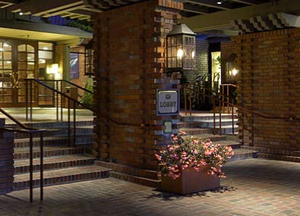
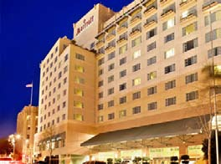
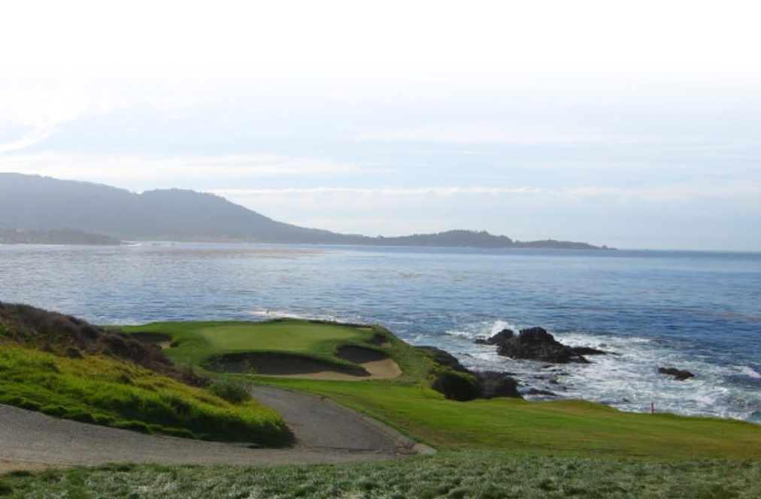




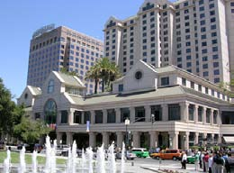
US OPEN 2010
June 14-20, 2010
Hotel Options
We have relationships with numerous major luxury hotel chains and can offer you and your guests options that include
(but are not limited to):
The Hyatt Regency Monterey
The Sheraton
The Hilton Garden Inn at Monterey
Marriott Monterey Bay Hotel
Hotels based on availability. For additional
options contact your PGS sales representative.
The Hyatt
The Marroitt
The Sheraton

Slide 6
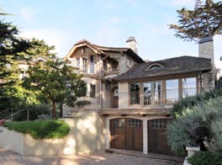
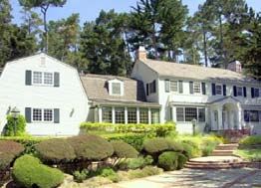
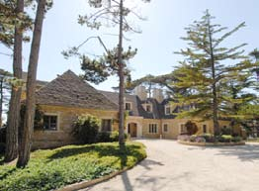
US OPEN 2010
June 14-20, 2010
Luxury Home Options
We have a reputation for securing it’s clients some of the finest private luxury homes in close proximity to a major event, and the 2010 US Open at Pebble Beach is no exception. Enjoy world class ocean views, beautiful cypress groves, cozy fireplaces, and castle-style bedrooms all while being at the center of the event. Many of our private homes are located directly on the legendary Pebble Beach Golf Links and will be without question the best place to watch the action!
Private home areas include:
Pebble Beach
Carmel
Carmel by the Sea
Monterey Area

Slide 7
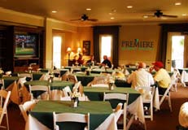
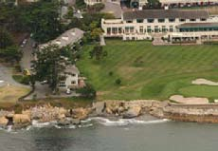

US OPEN 2010
June 14-20, 2010
Executive Club Hospitality
Located 100 yards from the 18th Green (above center) of Pebble Beach and Ocean Front. Executive Club Hospitality will include the following services and amenities:
Entrance credentials
Meet and greet reception desks with uniformed hostesses
Full American breakfast buffet with made to order omelet station
Elegant luncheon buffet, featuring salad bar and carving stations
Hot and cold hors d’oeuvres served every afternoon
Premium refreshments, and daily specialty drinks served throughout the day
Daily pairing sheets and 2010 US Open Tournament Guides
Secure check station to store merchandise, cell phones, etc.
Daily newspapers
20 large screen televisions and plasma screen televisions throughout the facility
Private outdoor patio garden area with TV’s, and comfortable seating
Concierge service. Our staff will familiarize you with Monterey’s best kept secrets, restaurants, hotels, historic sites, shopping, golf courses, etc.
24 hour security
Contact: Carlos@Broachsportstours.com or 1-800-849-6345
Local hospitality and ground tickets Thursday, Friday, Saturday and Sunday: $550 per person, per day
Local Hospitality and ground ticket Wednesday: $350
Table for 10 at the Executive Club (4 days): $21,000

Slide 8
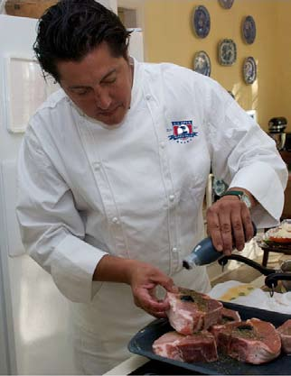
US OPEN 2010
June 14-20, 2010
Executive Club Hospitality
We can reserve a private party for you and your guests within our luxurious Executive Club facility.
BST can also arrange to have a personal chef come and prepare all of your meals for you. From gourmet dinners to made to order breakfast, a personal chef will take your US Open experience to the next level.
Below is a sample of our dinner menu. Assorted Passed Hors D’Oeuvres and a Dessert du Jour are also served with every meal.
Outback BBQ burgers, brats, chicken wings, vegetable kabobs, backed beans, bacon potato casserole, and slaw
Oven roasted baby rack of lamb, roasted garlic mashed potatoes, French beans
Marinated sliced flank steak over garlic herb French bread, Roma tomatoes, arugula, brie cheese, with roasted garlic
Country fried steak with English peas, onions, white gravy, and herb dusted fries
Veal Cutlet Milanese: sautéed breaded
veal cutlet topped with Roma tomatoes, arugula and red onion salad, balsamic vinaigrette, and shaved Romano cheese
BBQ ribs with sweet potato soufflé, baked apples, and buttered corn

Slide 9
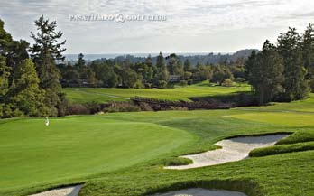
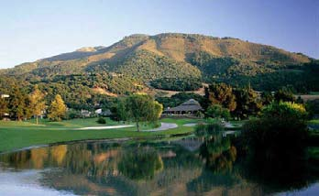
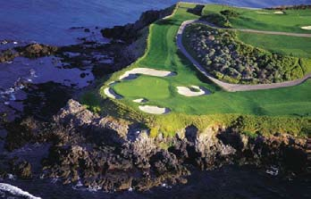
US OPEN 2010
June 14-20, 2010
Golf Options
PASATIEMPO
From greens that have challenged generations of golfers including Bobby Jones, Ken Venturi, Juli Inkster, and Tiger Woods, to rich golf history and breath-taking scenery, Pasatiempo delivers a memorable golf experience; it is truly one of the finest championship golf courses in the world.
CARMEL VALLEY RANCH
Cradled in the foothills of the Santa Lucia Mountains, the 400-acre Carmel Valley Ranch is the ideal golf environment. Having undergone a multi-million dollar enhancement, this chic Carmel golf resort boasts a refurbished Clubhouse and complete restoration of the original course design.
LINKS AT SPANISH BAY
Spanish Bay recalls the original Scottish concept of the game golf, established over five hundred years ago. This was the intention of the design team, Robert Trent Jones Jr., Tom Watson and Sandy Tatum, in their creation of a true links golf course. The Links at Spanish Bay are so authentic that even the Monterey coastline mirrors the rugged, natural beauty of Scotland.
Contact: Carlos@Broachsportstours.com
or 1-800-849-6345

